Slide 1
STOCK MARKET ANALYSIS
BY: Rutik Chavan

Slide 2
Agenda
Overview
What is Stock Market?
Dataset Summary
Scope of the project
Machine Learning
Architecture Of Stock Market Analysis
POWER BI Dashboard
Conclusion

Slide 3
Overview
The stock market is very unpredictable, any geopolitical change can impact the share trend of stocks in the share market, recently we have seen how covid-19 has impacted the stock prices, which is why on financial data doing a reliable trend analysis is very difficult. The most efficient way to solve this kind of issue is with the help of Machine learning and Deep learning. We are applying machine learning algorithms to find the accuracy of data.

Slide 4
What is Stock Market?
The stock market is where investors buy and sell shares of companies.
NSE stands for National Stock Exchange.
The National Stock Exchange of India Limited (NSE) is India's largest financial market and the fourth largest market by trading volume.
Each stock has it’s High, Close, Open, Low price per day.
Volume is no. of shares traded in days.
Dividend stocks are companies that pay out a portion of their profits to shareholders. These payouts can come monthly, quarterly, or annually.
Stock splits are generally done when the stock price of a company has risen so high that it might become an impediment to new investors. Therefore, a split is often the result of growth or the prospects of future growth, and it's a positive signal.

Slide 5
Dataset Summary
Using Streaming data from Yahoo Finance Library.
Ticker module is used to retrieve the data from online.
The dataset contains the date, open, high, low, close, volume, dividend, stock split values.
Dataset is based on past 5 years of the stocks data.

Slide 6
Scope of the project
Investors use various analysis techniques to predict the future outcomes of stock prices.
As the prices are very unpredictable investors deal with more difficulties for future predictions.
With the help of machine learning and deep learning, these difficulties can be solved.
Machine learning and Deep learning algorithms can predict future outcomes based on past data which will help many investors, organizations to deal with the losses and saving the time.

Slide 7
Machine Learning
Machine Learning is a branch of AI where, a machine is trained well enough to make decisions and predictions, for analysis and decision making.
Supervised and Unsupervised are the two types of machine learning algorithms.
Regression and Classifications analysis comes in Supervised Machine Learning.
We will be using Linear Regression for predicting future opening prices of stocks because it’s well suited for numerical and time series analysis data.

Slide 8
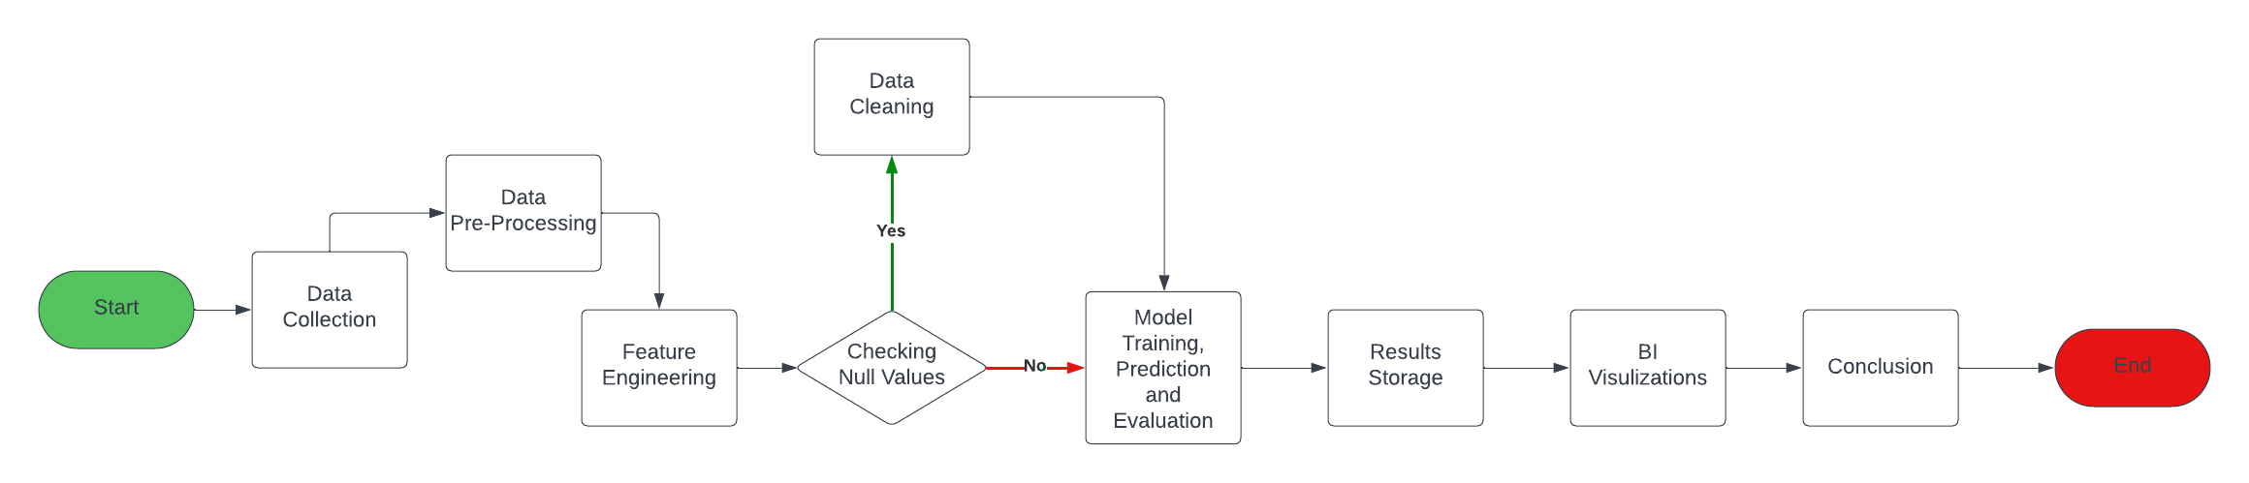
Architecture of Analysis

Slide 9
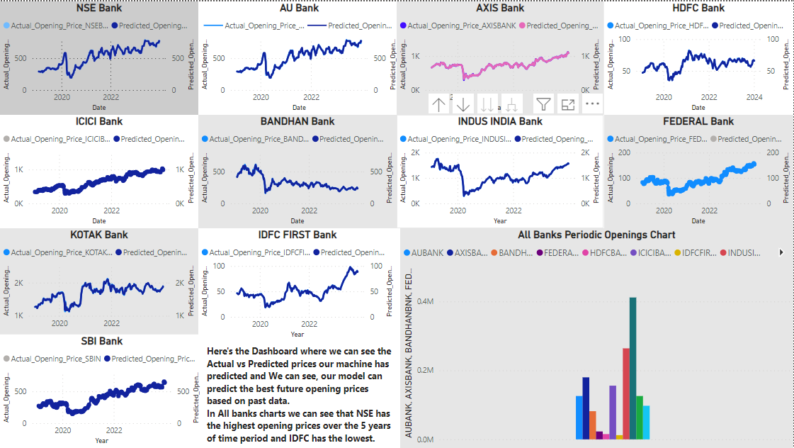
Power BI Dashboard

Slide 10
Conclusion
By using machine learning we can predict the future prices of stocks which will be helpful for investors to invest more consciously. Linear Regression is one of the best machine learning algorithm for predicting future outcomes and is best suited for the stock market prediction. And hence if we want to do in-depth analysis we can do using machine learning, deep learning.
By visualizing our results we can see that NSE has the highest openings prices over 5 years of time and IDFC FIRST Bank has the lowest opening prices.
Also, by the charts the investors can see where they can invest their amount in future.

Slide 11
Thank You !!!!!

